Slide 1

North Eastern Space Applications Centre
Government of India, Department of Space Umiam, Meghalaya
Vegetation Health Analysis
Assessing Vegetation Health Using Remote Sensing Data
Domain: Agricultural Applications
Date: 25 Oct 2024
Mentor: Dr. Pradesh Jena Team Members:
Dr. Chitrasen Lairenjam
Sudhan R
Tage Nobing

Slide 2
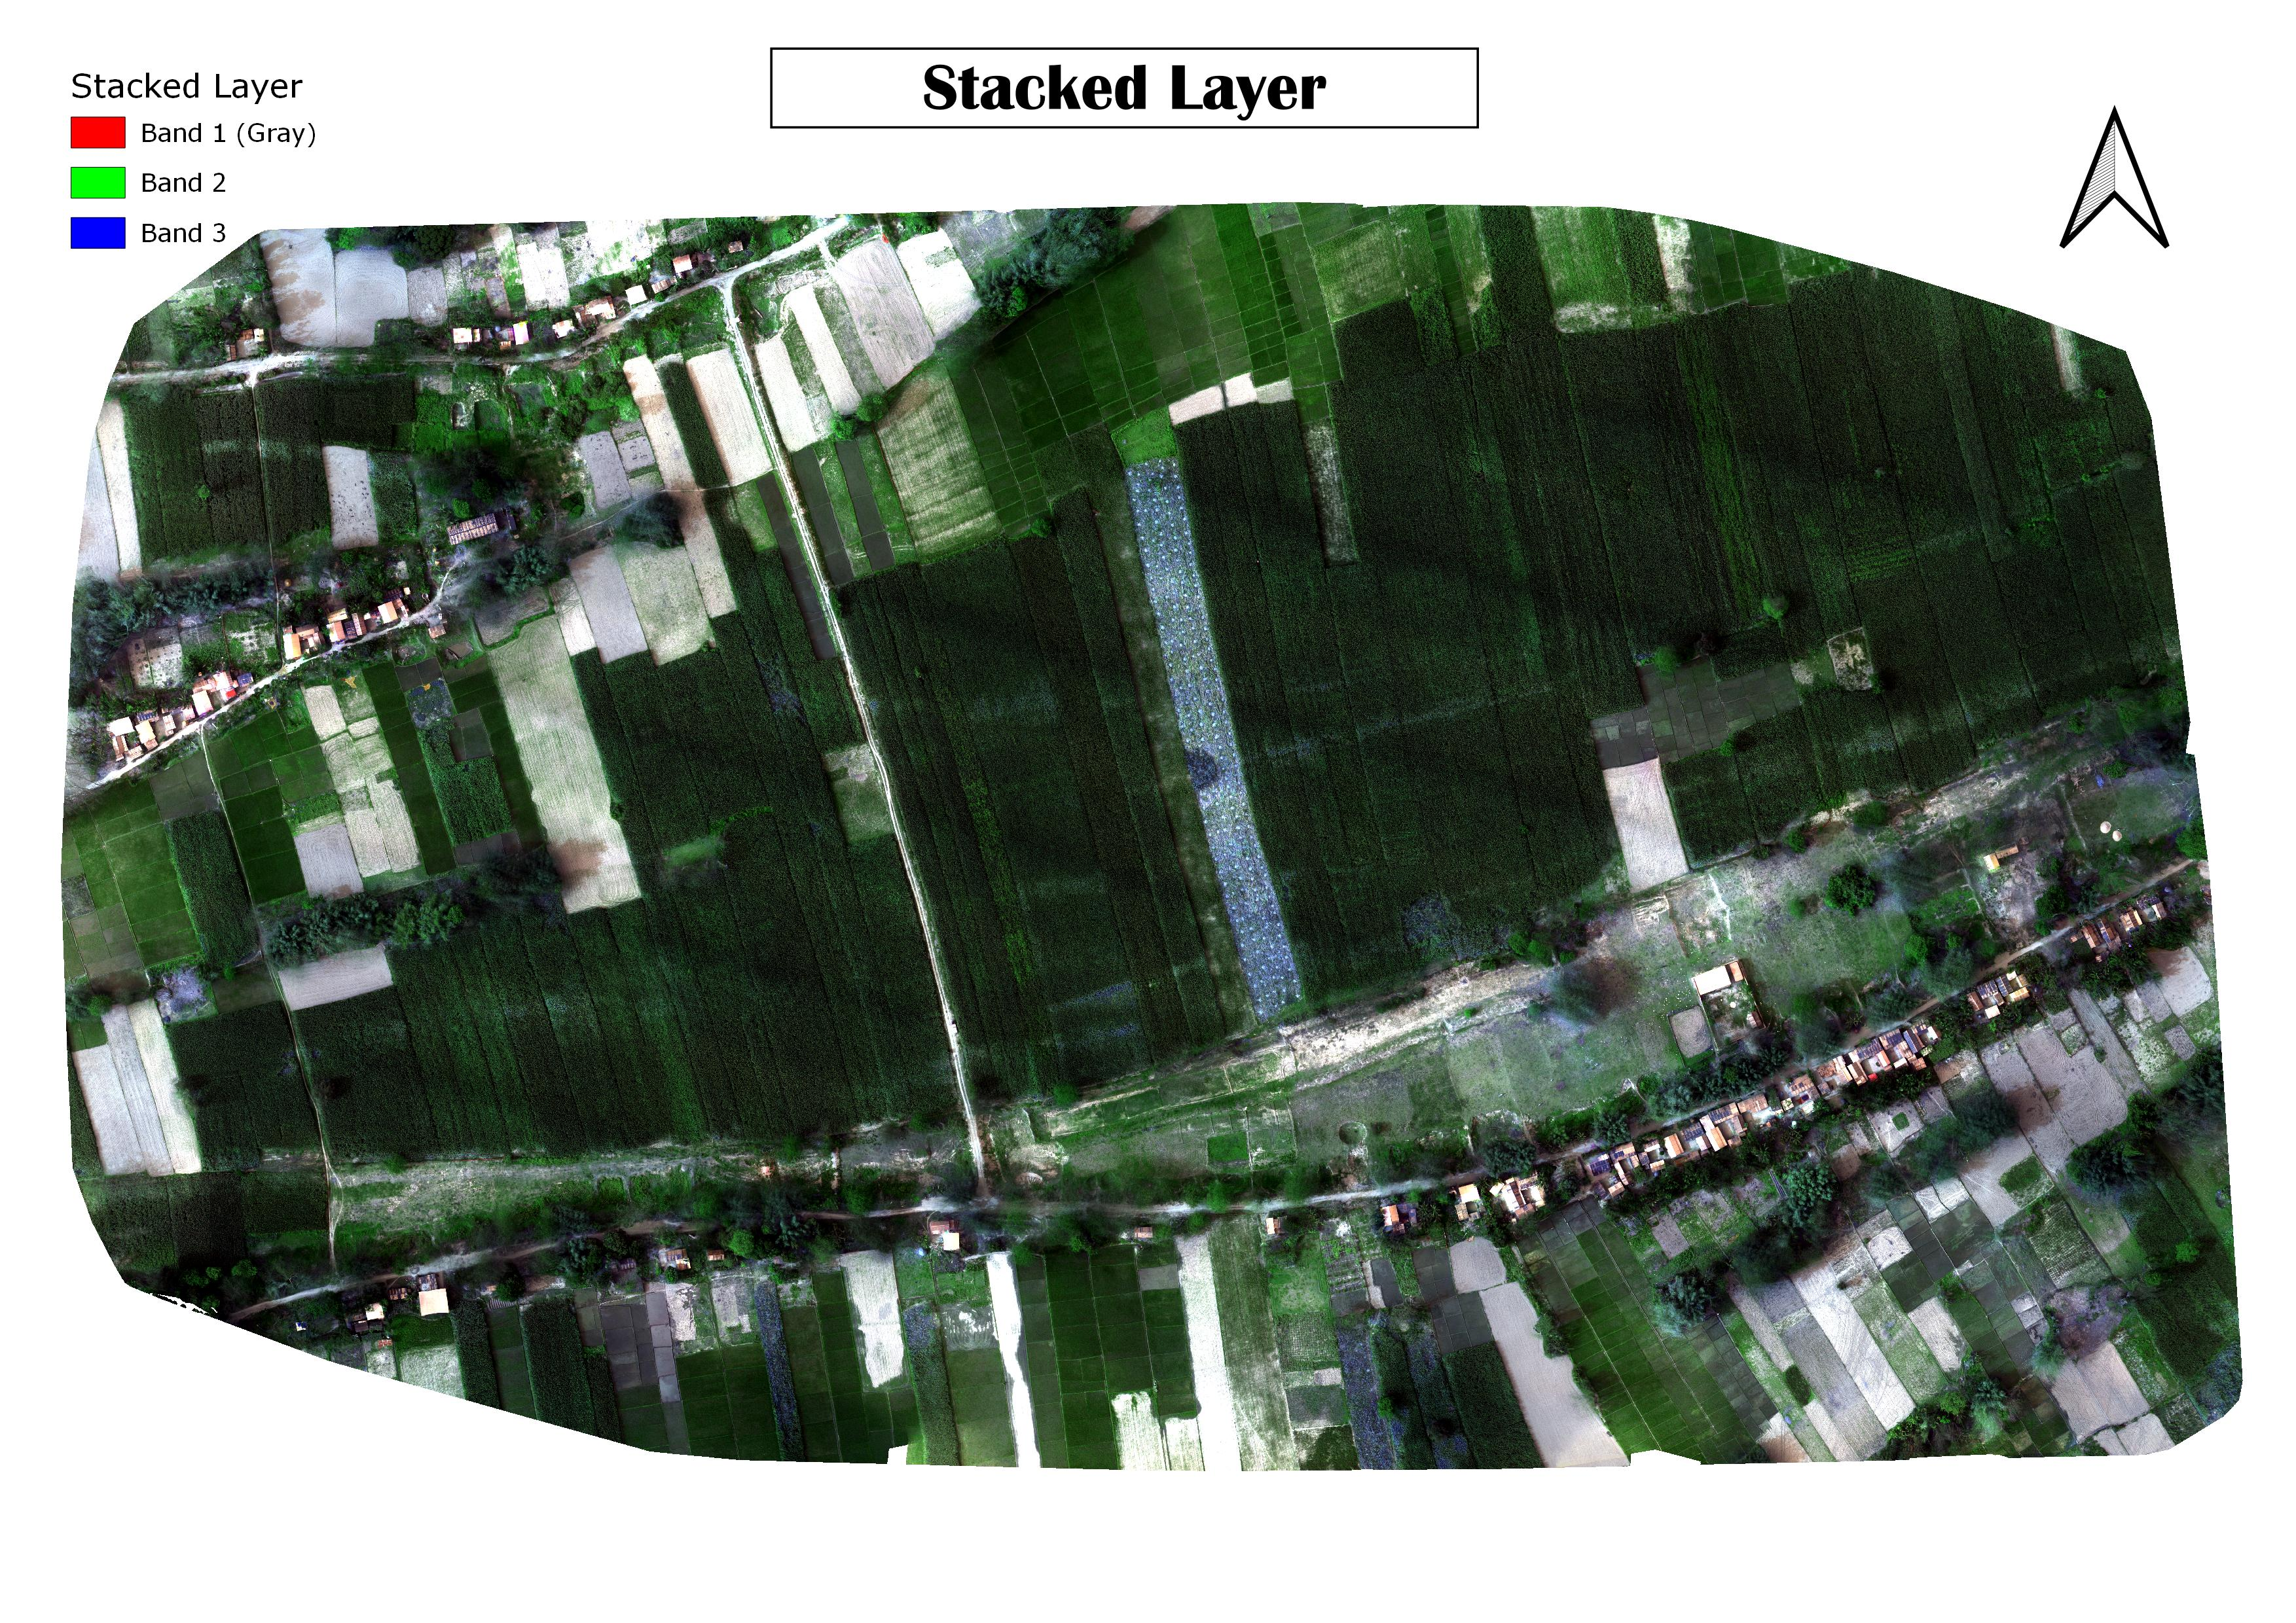
Project Overview
Objective: To identify cropped and non-cropped areas and assess vegetation stress levels using NDRE and NDVI.
Focus: Using NDRE and NDVI indices for accurate vegetation health monitoring.
Software: QGIS for data analysis and visualization, Tableau.
Area used for Analysis

Slide 3
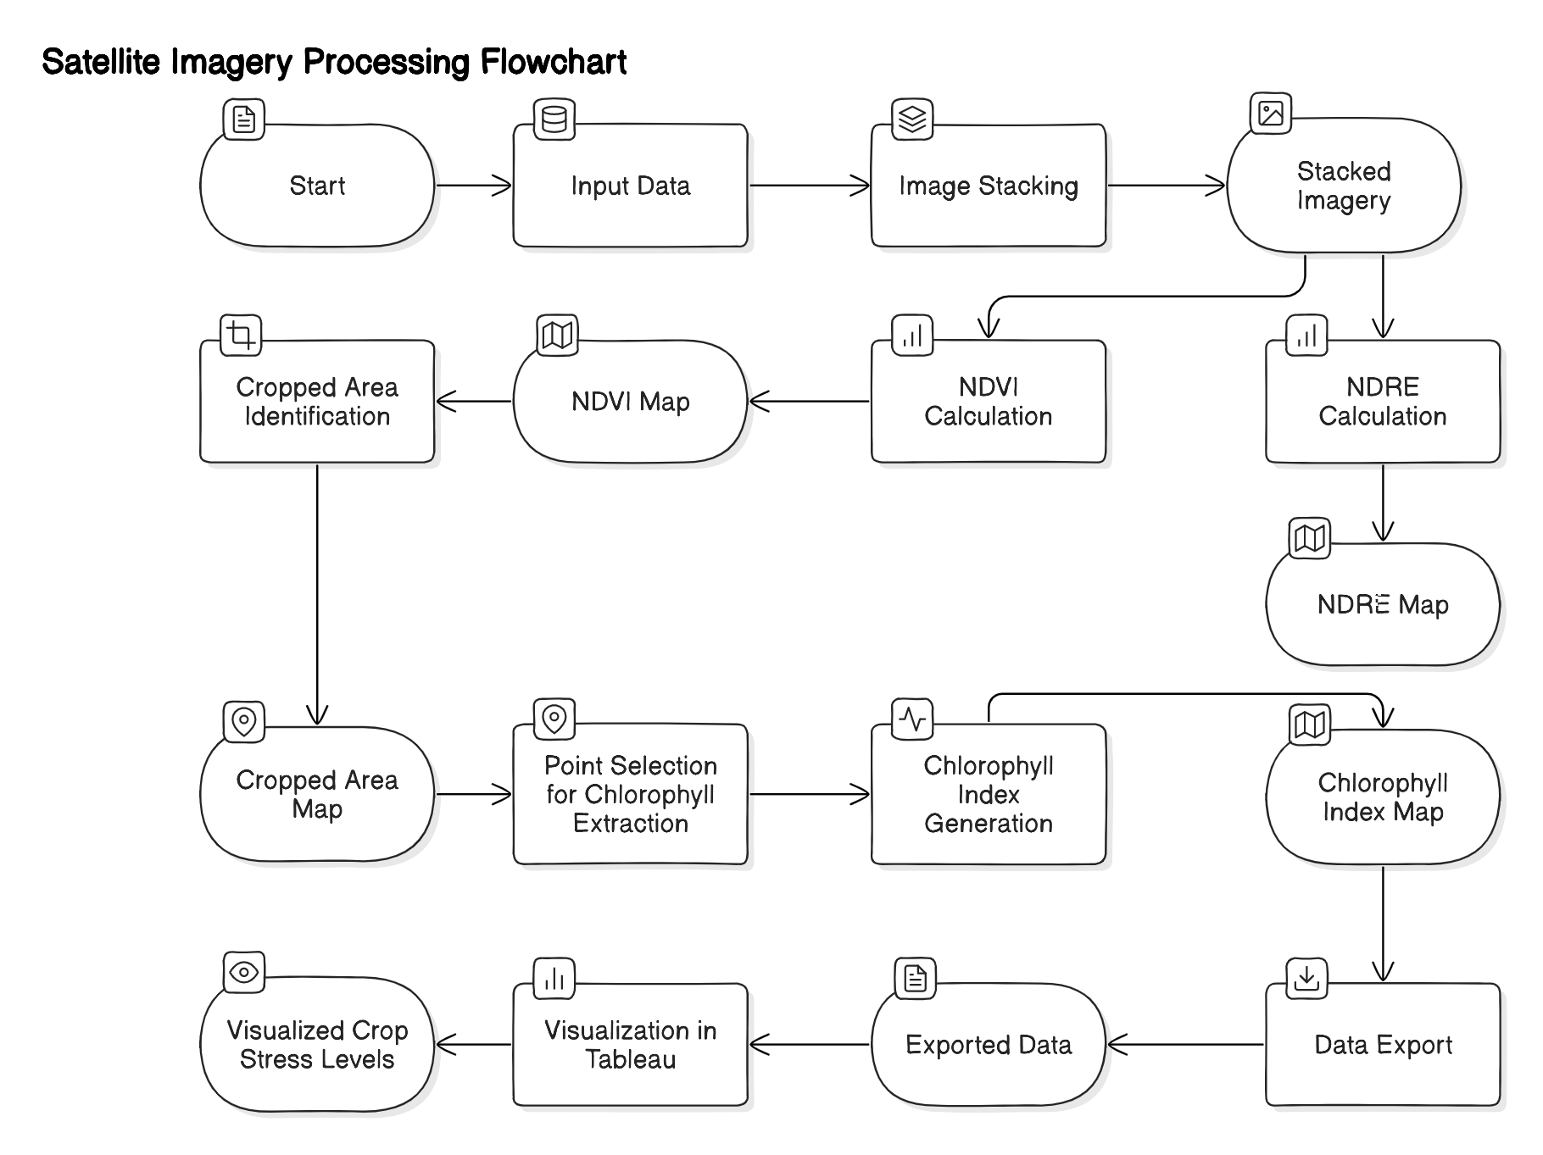
Data Flow Diagram

Slide 4
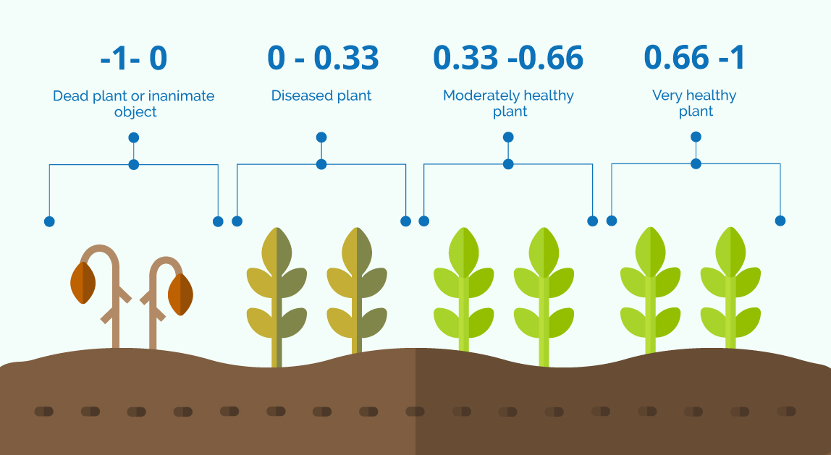

What is NDVI ?
NDVI, or greenness index, shows vegetation’s greenness, density, and health in each satellite image pixel.
It allows us to determine how healthy or unhealthy a plant is. Based on how it reflects energy and light, it uses the near-infrared and red bands of the electromagnetic spectrum to estimate a dimensionless indicator between -1 and 1.
$$\text{NDVI}\text{ =} \frac{\text{(}\text{NIR}\text{ – }\text{red}\text{)}}{\text{(}\text{NIR}\text{ + }\text{red}\text{)}}$$

Slide 5
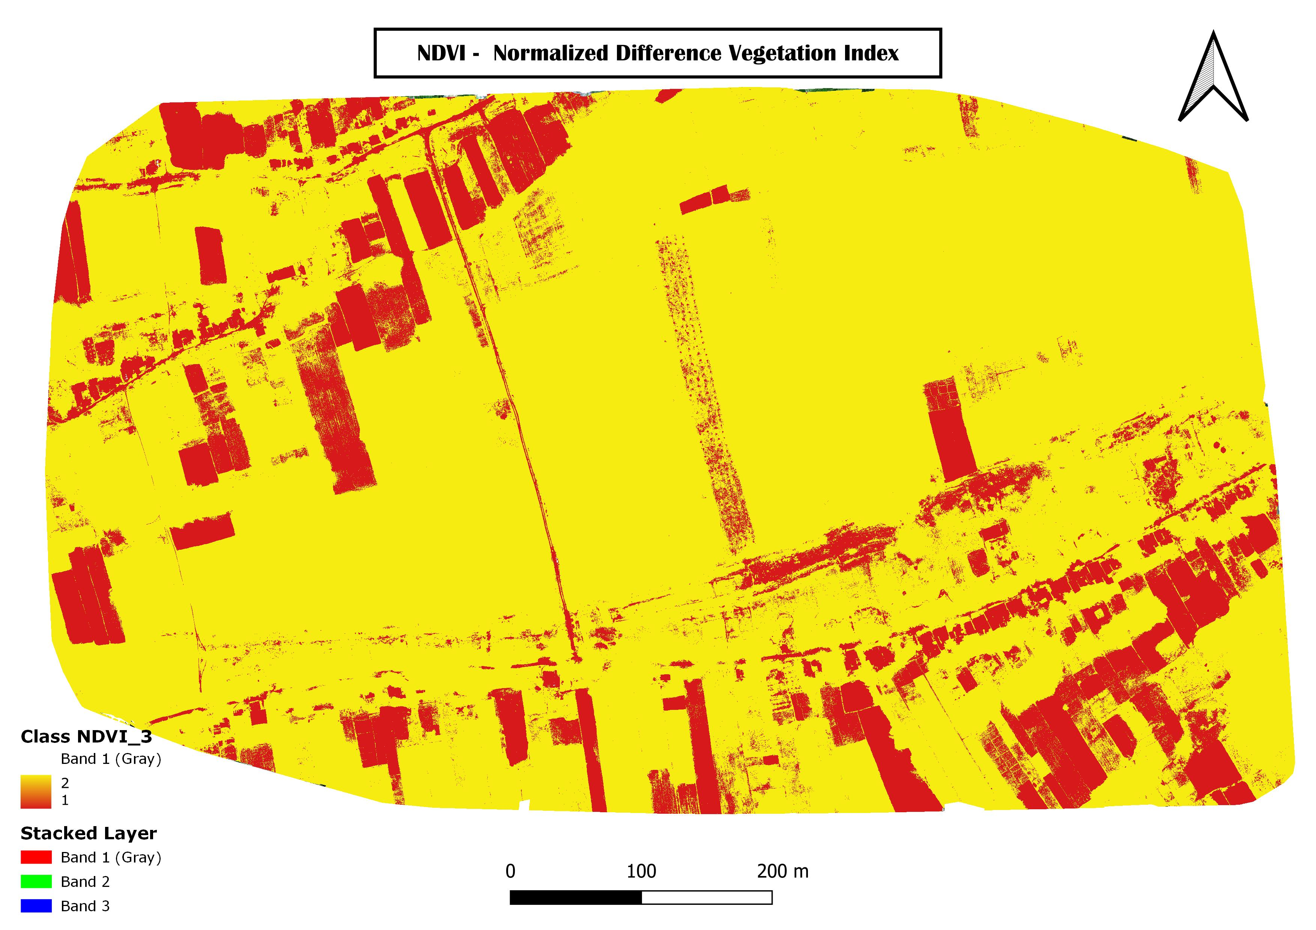
Normalized Difference Vegetation Index
Cropped Area
Non Cropped Area
Classified NDVI = ( NDVI < 0.35 ) *1 + ( NDVI $\text{≥}$ 0.35 )*2

Slide 6
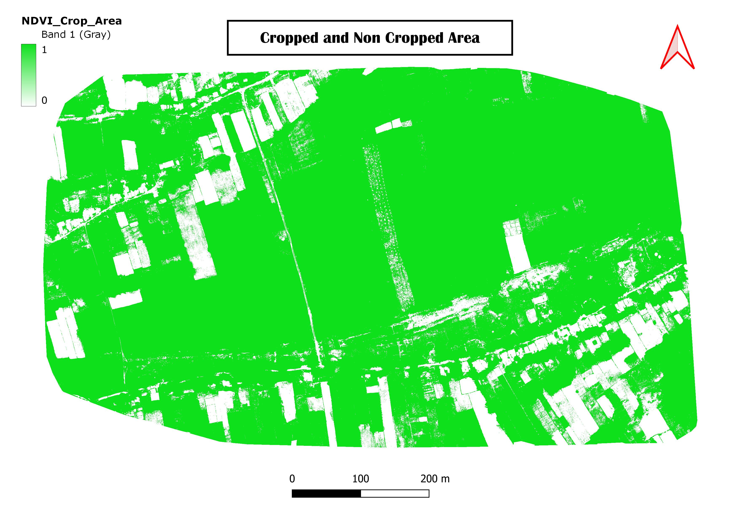
Cropped and Non-Cropped Area
Cropped Area
Non Cropped Area
Cropped Area = NDVI $\text{≥}$ 0.35

Slide 7
What is the NDRE ?
Definition: NDRE is an index similar to NDVI. It uses red-edged light that can penetrate leaves much more profoundly than red light (used in NDVI).
Importance: That is the main reason because it’s a safer solution, as it can detect variations in crop health at more advanced stages. Thus, with a more intense canopy, it is advisable to use NDRE because NDVI saturates.
NDRE = (NIR – RED EDGE)/(NIR + RED EDGE)

Slide 8
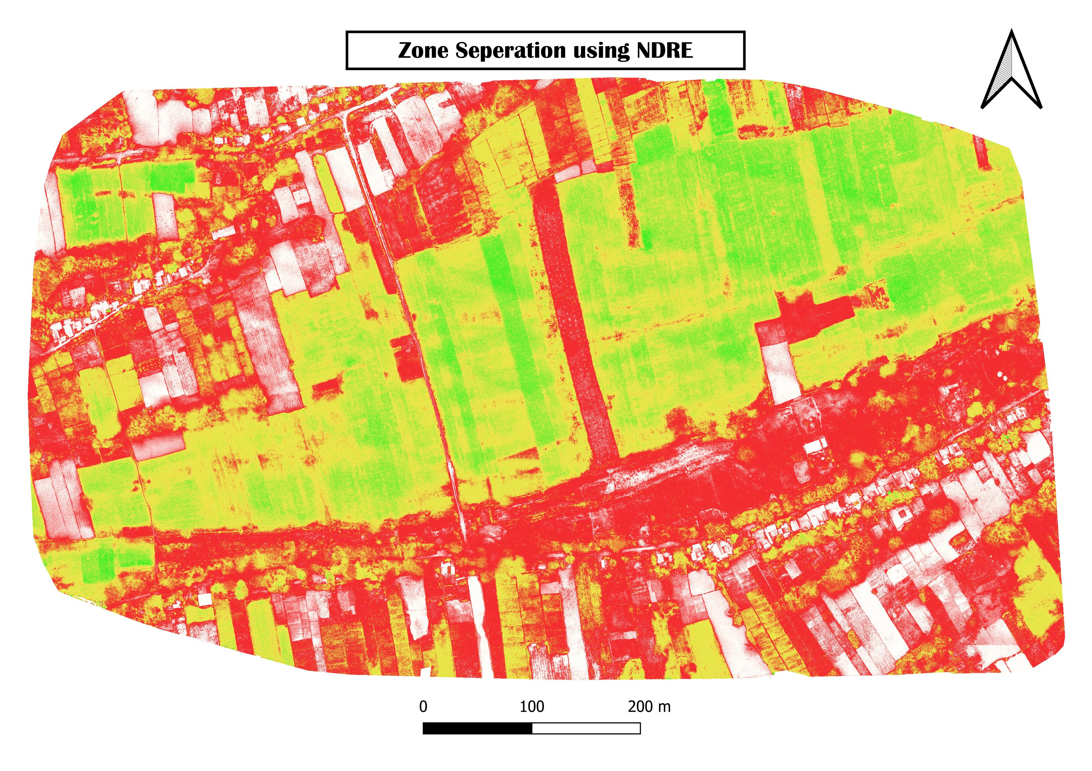
ZONE Separation using NDRE
Medium Stress
Non Cropped Area
Low Stress
High Stress

Slide 9
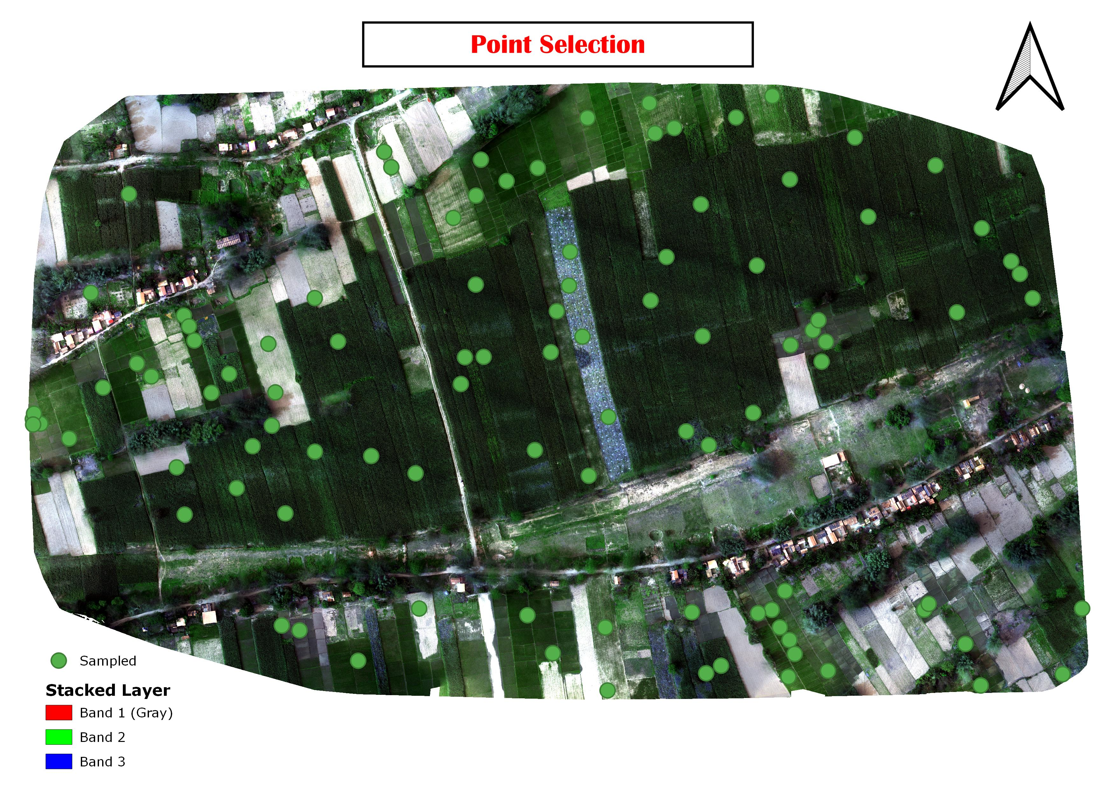
Point Selected for Extracting Chlorophyll Index
Definition: The Chlorophyll Index (CI) is a vegetation index used to estimate the chlorophyll content in plant leaves, which is directly related to their health and productivity. Chlorophyll is essential for photosynthesis, and its concentration can provide information about the vigor of the vegetation.
CHLOROPHYLL INDEX = (NIR / GREEN) - 1

Slide 10
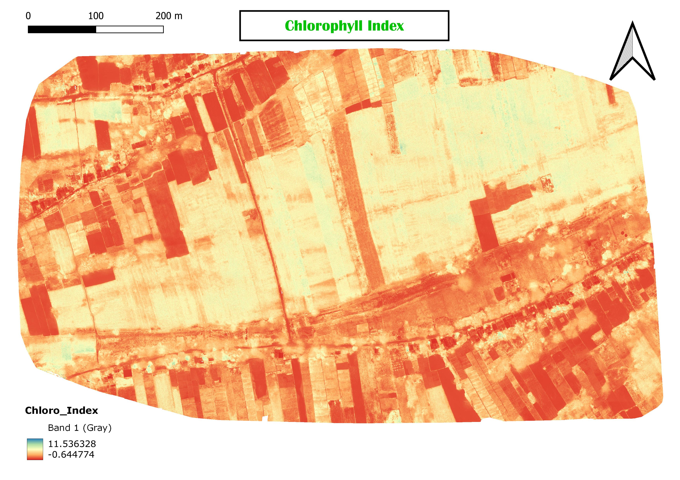
Chlorophyll Index

Slide 11
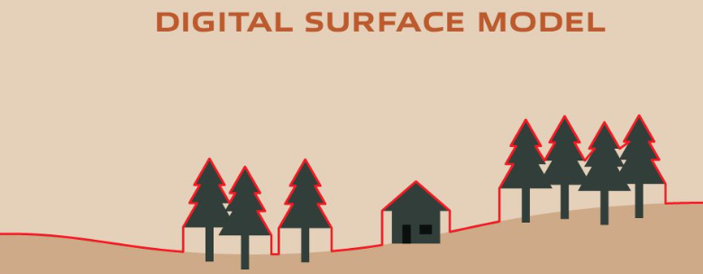
What is the DSM ?
Digital Surface Models, or DSMs, represent the topography of the earth’s surface, including all objects on it, such as trees, buildings, and other features. DSMs are created using aerial data capture methods, like LiDAR (Light Detection and Ranging) or photogrammetry.

Slide 12
Visualization
Symbology and Visualization
NDVI Symbology
Cropped Area
Non Cropped Area
Stress Level
NDRE Symbology
Zone Segmentation

Slide 13
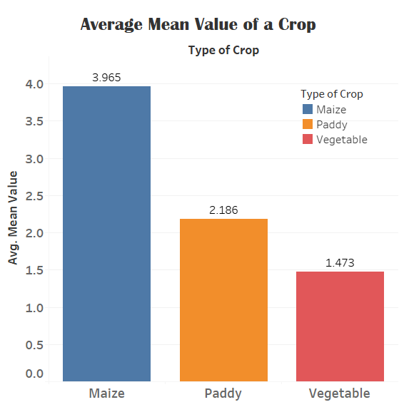
Results and Findings

Slide 14
References
GNDVI Calculation and Vegetation Analysis
Gitelson, A. A., & Merzlyak, M. N. (1994). Spectral Reflectance Changes Associated with Leaf Aging in Natural Deciduous Trees. Remote Sensing of Environment, 50(3), 367-373. https://doi.org/10.1016/0034-4257(94)90066-0
Using Remote Sensing for Vegetation Health Assessment
Pettorelli, N., Lintott, P. R., & Campbell, S. J. (2014). Satellite Remote Sensing for Applied Ecological Research: An Overview. Ecology and Evolution, 4(20), 4097-4106. https://doi.org/10.1002/ece3.1248
QGIS Software Reference
QGIS Development Team. (2023). QGIS Geographic Information System. Open Source Geospatial Foundation Project. Retrieved from https://qgis.org

Slide 15
North Eastern Space Applications Centre
Government of India, Department of Space Umiam, Meghalaya
Thank you!!!

